Slide 1

Unit-8: String Matching
Analysis and Design of Algorithms (ADA)
GTU # 3150703
Dr. Gopi Sanghani
Computer Engineering Department
gopi.sanghani@darshan.ac.in
9825621471

Slide 2

Outline
Introduction
The Naive String Matching Algorithm
The Rabin-Karp Algorithm
String Matching with Finite Automata
The Knuth-Morris-Pratt Algorithm
Looping

Slide 3
Introduction
Text-editing programs frequently need to find all occurrences of a pattern in the text.
Efficient algorithms for this problem is called String-Matching Algorithms.
Among its many applications, “String-Matching” is highly used in Searching for patterns in DNA and Internet search engines.
Assume that the text is represented in the form of an array 𝑻[𝟏…𝒏] and the pattern is an array 𝑷[𝟏…𝒎].
Text T[1..13]
a
b
c
a
b
a
a
b
c
a
b
a
c
Pattern P[1..4]
a
b
a
a

Slide 4
Naive String Matching Algorithm

Slide 5
Naive String Matching - Example
The naive algorithm finds all valid shifts using a loop that checks the condition P[1..m] = T[s+1..s+m]
a
c
a
a
b
c
a
c
a
a
b
c
a
c
a
a
b
c
a
a
b
a
a
b
a
a
b
s = 0
s = 1
s = 2
a
c
a
a
b
c
Pattern matched with shift 2
P[1..m] = T[s+1..s+m]
a
a
b
s = 3

Slide 6
Naive String Matching - Algorithm
NAIVE-STRING MATCHER (T,P)
n = T.length
m = P.length
for s = 0 to n-m
if p[1..m] == T[s+1..s+m]
print “Pattern occurs with shift” s
T[1..6]
a
c
a
a
b
c
P[1..3]
a
a
a
a
a
b
a
a
b
b
a
b
2
s = 0
1
3
Pattern occurs with shift 2
Naive String Matcher takes time O((n-m+1)m)

Slide 7
Rabin-Karp Algorithm

Slide 8
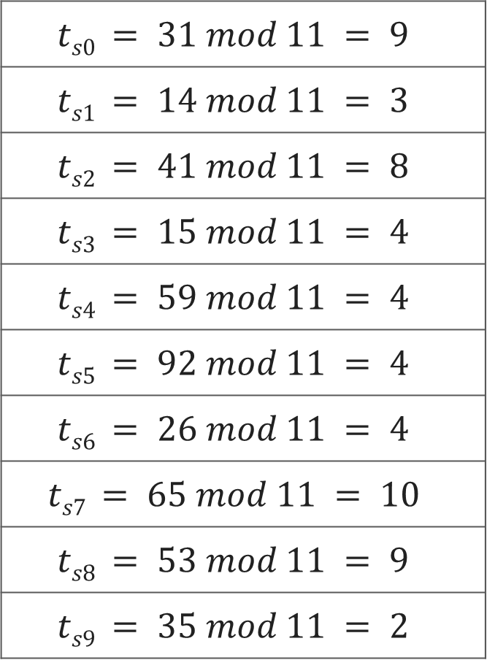
Text T
3 | 1 | 4 | 1 | 5 | 9 | 2 | 6 | 5 | 3 | 5
$$ts0 = 31 mod 11 = 9$$
$$ts1 = 14 mod 11 = 3$$
$$ts2 = 41 mod 11 = 8$$
$$ts3 = 15 mod 11 = 4$$
$$ts4 = 59 mod 11 = 4$$
$$ts5 = 92 mod 11 = 4$$
$$ts6 = 26 mod 11 = 4$$
$$ts7 = 65 mod 11 = 10$$
$$ts8 = 53 mod 11 = 9$$
$$ts9 = 35 mod 11 = 2$$
Pattern P
2 | 6
Choose a random prime number q = 11
Let, p = P mod q
= 26 mod 11 = 4
Let t_{s} denotes modulo q for text of length m
3 | 1 | 4 | 1 | 5 | 9 | 2 | 6 | 5 | 3 | 5
9 | 3 | 8 | 4 | 4 | 4 | 4 | 10 | 9 | 2

Slide 9
Pattern P
2 | 6
p = P mod q = 26 mod 11 = 4
2 | 6
Text T
3 | 1 | 4 | 1 | 5 | 9 | 2 | 6 | 5 | 3 | 5
t_{s}
9 | 3 | 8 | 4 | 4 | 4 | 4 | 10 | 9 | 2
Spurious Hit
Valid match
if t_{s} == p
if P[1..m] == T[s+1..s+m]
print “pattern occurs with shift” s

Slide 10

Rabin-Karp Algorithm
We can compute $t_{s}$ using following formula
t_{s+1} = 10(t_{s} - 10^{m-1}T[s+1]) + T[s + m + 1]
3 | 1 | 4 | 1 | 5 | 9 | 2 | 6 | 5 | 3 | 5
For m=2 and s=0 t_{s} = 31
We wish to remove higher order digit T[s+1]=3 and bring the new lower order digit T[s+m+1]=4
t_{s+1} = 10(31-10·3) + 4
= 10(1) + 4 = 14
t_{s+2} = 10(14-10·1) + 1
= 10(4) + 1 = 41

Slide 11
Rabin-Karp-Matcher
RABIN-KARP-MATCHER(T, P, d, q)
n ← length[T];
m ← length[P];
h ← d^{m-1} mod q;
p ← 0;
t₀ ← 0;
for i ← 1 to m do
p ← (d_{p} + P[i]) mod q
t₀ ← (dt₀ + T[i]) mod q
for s ← 0 to n – m do
if p == t_{s} then
if P[1..m] == T[s+1..s+m] then
print “pattern occurs with shift” s
if s < n-m then
t_{s+1} ← (d(t_{s} – T[s+1]h) + T[s+m+1]) mod q
T | 3 | 1 | 4 | 1 | 5 | 9 | 2 | 6 | 5 | 3 | 5
P | 2 | 6
d | 10
q | 11
n | 11
m | 2
h | 10
t₀ | 9
p | 4
t₀ | 0
p | 0

Slide 12
String Matching with Finite Automata

Slide 13
Introduction to Finite Automata
Finite automaton (FA) is a simple machine, used to recognize patterns.
It has a set of states and rules for moving from one state to another.
It takes the string of symbol as input and changes its state accordingly. When the desired symbol is found, then the transition occurs.
At the time of transition, the automata can either move to the next state or stay in the same state.
When the input string is processed successfully, and the automata reached its final state, then it will accept the input string.
The string-matching automaton is very efficient: it examines each character in the text exactly once and reports all the valid shifts.

Slide 14


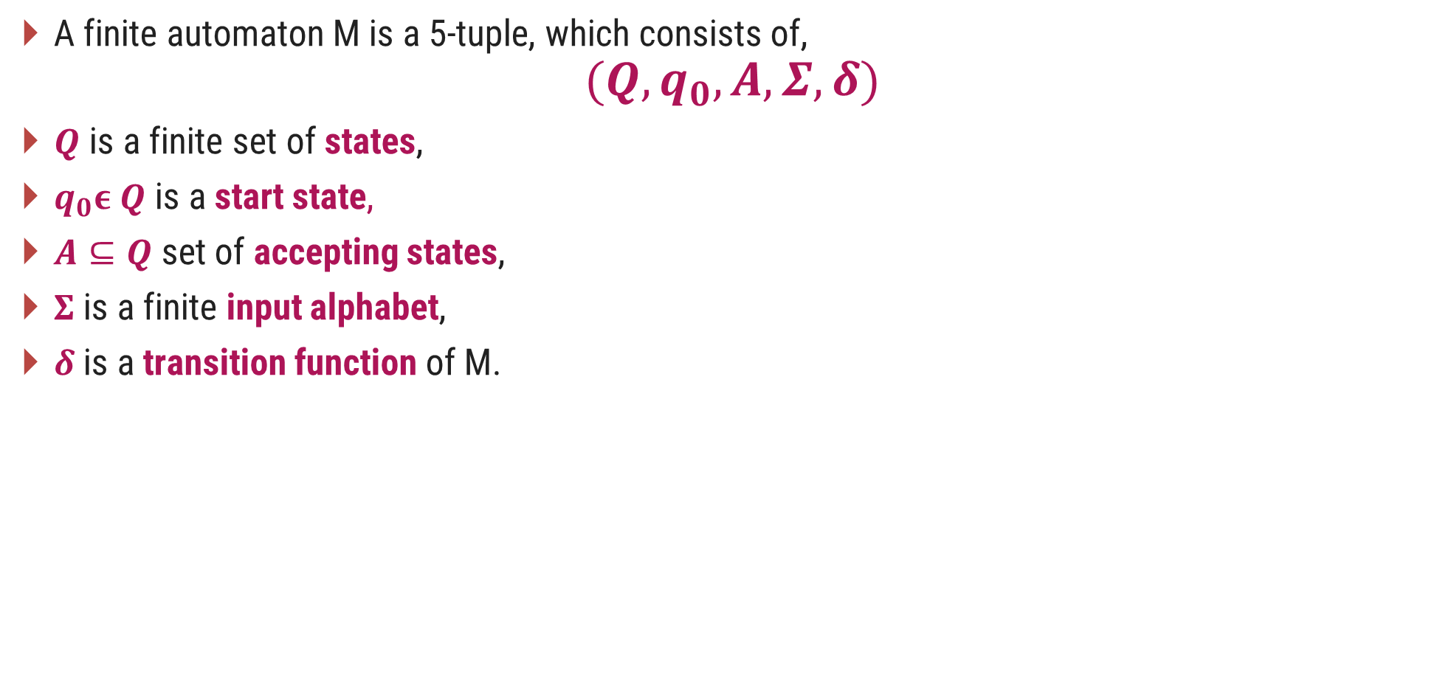



Introduction to Finite Automata
A finite automaton M is a 5-tuple, which consists of,
$$(Q,q_{0}, A,Σ,δ)$$
$Q$ is a finite set of states,
$q_{0}ε Q$ is a start state,
$A⊆Q$set of accepting states,
$Σ$is a finite input alphabet,
$δ$ is a transition function of M.
$$Q=\{0,1\}$$
$$q_{0}=0$$
$$A=\{1\}$$
$$Σ=\{a,b\}$$
$$δ\left(1,b\right)=0$$
 | Input
State | a | b
0 | 1 | 0
1 | 0 | 0
a
b
0
1
a
b
Transition Table
Finite Automaton

Slide 15
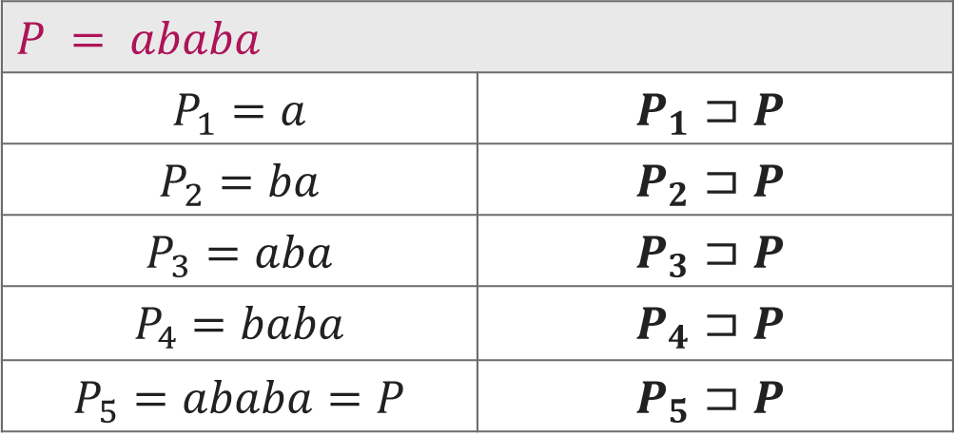

Suffix of String
Suffix of a string is any number of trailing symbols of that string. If a string $ω$ is a suffix of a string $x$ then it is denoted by $ω⊐x$.
$$P = ababa$$
$$P_{1}=a$$ | $$P_{1}⊐P$$
$$P_{2}=ba$$ | $$P_{2}⊐P$$
$$P_{3}=aba$$ | $$P_{3}⊐P$$
$$P_{4}=baba$$ | $$P_{4}⊐P$$
$$P_{5}=ababa=P$$ | $$P_{5}⊐P$$

Slide 16
Compute Transition Function
COMPUTE-TRANSITION-FUNCTION(P, Σ )
m ← length[P]
for q ← 0 to m do
for each character α Є Σ do
k ← min(m + 1, q + 2)
repeat k ← k – 1 until P_{k} ⊐ P_{q}α
δ(q, α) ← k
return δ

Slide 17
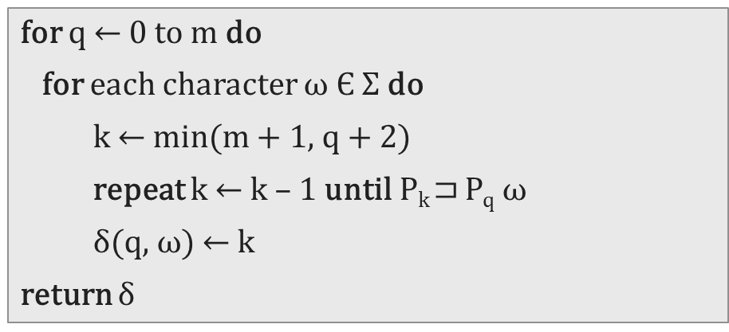
 | 1 | 2 | 3 | 4 | 5 | 6 | 7
Pattern | a | b | a | b | a | c | a
for q ← 0 to m do
for each character $ω$ Є Σ do
k ← min(m + 1, q + 2)
repeat k ← k – 1 until P_{k} ⊐ P_{q} $ω$
δ(q, $ω$) ← k
return δ
Σ = {a, b, c}
1 | 2 | 3 | 4 | 5 | 6 | 7
m = 7
 | input
State | a | b | c
0 | 1 | 0 | 0
1
2
3
4
5
6
7
q=0 | ω=a | k=2 | P₂⊐P₀ω | ab⊐ϵa
k=1 | P₁⊐P₀ω | a⊐ϵa
ω=b | k=2 | P₂⊐P₀ω | ab⊐ϵb
k=1 | P₁⊐P₀ω | a⊐ϵb
k=0 | P₀⊐P₀ω | ϵ⊐ϵb
ω=c | k=2 | P₂⊐P₀ω | ab⊐ϵc
k=1 | P₁⊐P₀ω | a⊐ϵc
k=0 | P₀⊐P₀ω | ϵ⊐ϵc

Slide 18
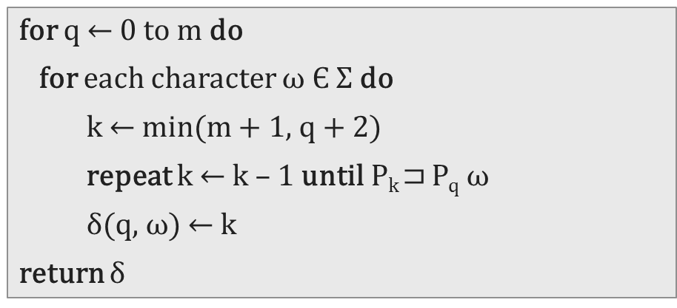
 | 1 | 2 | 3 | 4 | 5 | 6 | 7
Pattern | a | b | a | b | a | c | a
for q ← 0 to m do
for each character $ω$ Є Σ do
k ← min(m + 1, q + 2)
repeat k ← k – 1 until P_{k} ⊐ P_{q} $ω$
δ(q, $ω$) ← k
return δ
Σ = {a, b, c}
1 | 2 | 3 | 4 | 5 | 6 | 7
m = 7
 | input
State | a | b | c
0 | 1 | 0 | 0
1 | 1 | 2 | 0
2
3
4
5
6
7
q=1 | ω=a | k=3 | P₃⊐P₁ω | aba⊐aa
k=2 | P₂⊐P₁ω | ab⊐aa
k=1 | P₁⊐P₁ω | a⊐aa
ω=b | k=3 | P₃⊐P₁ω | aba⊐ab
k=2 | P₂⊐P₁ω | ab⊐ab
ω=c | k=3 | P₃⊐P₁ω | aba⊐ac
k=2 | P₂⊐P₁ω | ab⊐ac
k=1 | P₁⊐P₁ω | a⊐ac
k=0 | P₀⊐P₁ω | ϵ⊐ac

Slide 19
 | 1 | 2 | 3 | 4 | 5 | 6 | 7
Pattern | a | b | a | b | a | c | a
for q ← 0 to m do
for each character $ω$ Є Σ do
k ← min(m + 1, q + 2)
repeat k ← k – 1 until P_{k} ⊐ P_{q} $ω$
δ(q, $ω$) ← k
return δ
Σ = {a, b, c}
1 | 2 | 3 | 4 | 5 | 6 | 7
m = 7
 | input
State | a | b | c
0 | 1 | 0 | 0
1 | 1 | 2 | 0
2 | 3 | 0 | 0
3 | 1 | 4 | 0
4 | 5 | 0 | 0
5 | 1 | 4 | 6
6 | 7 | 0 | 0
7 | 1 | 2 | 0
q=2 | ω=a | k=4 | P₄⊐P₂ω | abab⊐aba
k=3 | P₃⊐P₂ω | aba⊐aba
ω=b | k=0 | P₀⊐P₂ω | ϵ⊐abb
ω=c | k=0 | P₀⊐P₂ω | ϵ⊐abc
q=3 | ω=a | k=1 | P₁⊐P₃ω | a⊐abaa
ω=b | k=4 | P₄⊐P₃ω | abab⊐abab
ω=c | k=0 | P₀⊐P₃ω | ϵ⊐abac

Slide 20

Finite Automata Matcher
FINITE-AUTOMATON MATCHER(T, δ, m)
n ← length[T]
q ← 0
for i ← 1 to n do
q ← δ(q, T[i])
if q == m then
print "Pattern occurs with shift" i – m
$$q=δ(0,a)=1$$
$$q=δ(1,b)=2$$
$$q=δ(2,a)=3$$
$$q=δ(3,b)=4$$
$$q=δ(4,a)=5$$
$$q=δ(5,b)=4$$
$$q=δ(4,a)=5$$
 | input
State | a | b | c
0 | 1 | 0 | 0
1 | 1 | 2 | 0
2 | 3 | 0 | 0
3 | 1 | 4 | 0
4 | 5 | 0 | 0
5 | 1 | 4 | 6
6 | 7 | 0 | 0
7 | 1 | 2 | 0
i =
6
3
1
5
4
2
7
q =
4
5
4
0
1
2
5
3
 | 1 | 2 | 3 | 4 | 5 | 6 | 7
Pattern | a | b | a | b | a | c | a
 | 1 | 2 | 3 | 4 | 5 | 6 | 7 | 8 | 9 | 10 | 11
Text | a | b | a | b | a | b | a | c | a | b | a

Slide 21

Finite Automata Matcher
FINITE-AUTOMATON MATCHER(T, δ, m)
n ← length[T]
q ← 0
for i ← 1 to n do
q ← δ(q, T[i])
if q == m then
print "Pattern occurs with shift" i – m
$$q=δ(0,a)=1$$
$$q=δ(1,b)=2$$
$$q=δ(2,a)=3$$
$$q=δ(3,b)=4$$
$$q=δ(4,a)=5$$
$$q=δ(5,b)=4$$
$$q=δ(4,a)=5$$
$$q=δ(5,c)=6$$
$$q=δ(6,a)=7$$
 | input
State | a | b | c
0 | 1 | 0 | 0
1 | 1 | 2 | 0
2 | 3 | 0 | 0
3 | 1 | 4 | 0
4 | 5 | 0 | 0
5 | 1 | 4 | 6
6 | 7 | 0 | 0
7 | 1 | 2 | 0
i =
8
9
6
3
1
5
4
2
7
q =
6
4
5
4
7
0
1
2
5
3
 | 1 | 2 | 3 | 4 | 5 | 6 | 7
Pattern | a | b | a | b | a | c | a
 | 1 | 2 | 3 | 4 | 5 | 6 | 7 | 8 | 9 | 10 | 11
Text | a | b | a | b | a | b | a | c | a | b | a

Slide 22
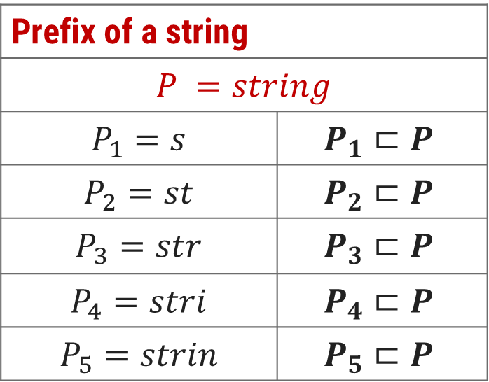
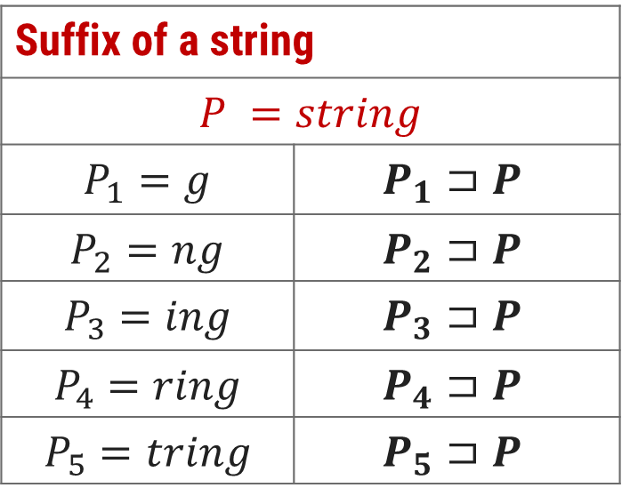
Suffix & Prefix of a String
Suffix of a string
$$P =string$$
$$P_{1}=g$$ | $$P_{1}⊐P$$
$$P_{2}=ng$$ | $$P_{2}⊐P$$
$$P_{3}=ing$$ | $$P_{3}⊐P$$
$$P_{4}=ring$$ | $$P_{4}⊐P$$
$$P_{5}=tring$$ | $$P_{5}⊐P$$
Prefix of a string
$P =string$
$$P_{1}=s$$ | $$P_{1}⊏P$$
$$P_{2}=st$$ | $$P_{2}⊏P$$
$$P_{3}=str$$ | $$P_{3}⊏P$$
$$P_{4}=stri$$ | $$P_{4}⊏P$$
$$P_{5}=strin$$ | $$P_{5}⊏P$$

Slide 23
String Matching with Knuth-Morris-Pratt Algorithm

Slide 24
Introduction
The KMP algorithm relies on prefix function (π).
Proper prefix: All the characters in a string, with one or more cut off the end. “S”, “Sn”, “Sna”, and “Snap” are all the proper prefixes of “Snape”.
Proper suffix: All the characters in a string, with one or more cut off the beginning. “agrid”, “grid”, “rid”, “id”, and “d” are all proper suffixes of “Hagrid”.
KMP algorithm works as follows:
Step-1: Calculate Prefix Function
Step-2: Match Pattern with Text

Slide 25
Longest Common Prefix and Suffix
 | 1 | 2 | 3 | 4 | 5 | 6 | 7
Pattern | a | b | a | b | a | c | a
Prefix(π) | 0 | 0 | 1 | 2 | 3 | 0 | 1
ababa
abab
aba
ab
a
We have no possible prefixes
Possible prefix = a
Possible prefix = a, ab, aba, abab
Possible prefix = a, ab
Possible prefix = a, ab, aba
We have no possible suffixes
Possible suffix = b
Possible suffix = a, ba, aba, baba
Possible suffix = a, ba
Possible suffix = b, ab, bab

Slide 26
Calculate Prefix Function - Example
k+1
q
q
k+1
 | 1 | 2 | 3 | 4 | 5 | 6 | 7
P | a | c | a | c | a | g | t
π | 0 | 0 | 1 | 2 | 3 | 0 | 0
false
P[k+1]==P[q]
true
k =
0
1
2
3
1
0
q =
2
3
4
5
6
7
false
k>0
true
Initially set π[1] = 0
k is the longest prefix found
q is the current index of pattern
k=π[k]
k=k+1
π[q]=k

Slide 27
KMP- Compute Prefix Function
COMPUTE-PREFIX-FUNCTION(P)
m ← length[P]
π[1] ← 0
k ← 0
for q ← 2 to m
while k > 0 and P[k + 1] ≠ P[q]
k ← π[k]
end while
if P[k + 1] == P[q] then
k ← k + 1
end if
π[q] ← k
return π

Slide 28
KMP String Matching
 | 1 | 2 | 3 | 4 | 5 | 6 | 7
Pattern | a | c | a | c | a | g | t
Prefix(π) | 0 | 0 | 1 | 2 | 3 | 0 | 0
T | a | c | a | t | a | c | g | a | c | a | c | a | g | t
Mismatch ?
Check value in prefix table
a
c
a
c
a
g
t
a
c
a
c
a
g
t
We can skip 2 shifts
(Skip unnecessary shifts)
T | a | c | a | t | a | c | g | a | c | a | c | a | g | t
a
c
a
c
a
g
t
Mismatch ?
Check value in prefix table
T | a | c | a | t | a | c | g | a | c | a | c | a | g | t
a
c
a
c
a
g
t
Mismatch ?
Check value in prefix table

Slide 29
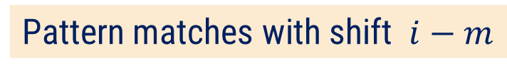
KMP String Matching
 | 1 | 2 | 3 | 4 | 5 | 6 | 7
Pattern | a | c | a | c | a | g | t
Prefix(π) | 0 | 0 | 1 | 2 | 3 | 0 | 0
T | a | c | a | t | a | c | g | a | c | a | c | a | g | t
Mismatch ?
Check value in prefix table
a
c
a
c
a
g
t
We can skip 2 shifts
(Skip unnecessary shifts)
T | a | c | a | t | a | c | g | a | c | a | c | a | g | t
a
c
a
c
a
g
t
T | a | c | a | t | a | c | g | a | c | a | c | a | g | t
a
c
a
c
a
g
t
Pattern matches with shift $i−m$

Slide 30
KMP-MATCHER
KMP-MATCHER(T, P)
n ← length[T]
m ← length[P]
π ← COMPUTE-PREFIX-FUNCTION(P)
q ← 0 //Number of characters matched.
for i ← 1 to n //Scan the text from left to right.
while q > 0 and P[q + 1] ≠ T[i]
q ← π[q] //Next character does not match.
if P[q + 1] == T[i] then
then q ← q + 1 //Next character matches.
if q == m then //Is all of P matched?
print "Pattern occurs with shift" i - m
q ← π[q] //Look for the next match.

Slide 31
Thank You!

